Slide 1
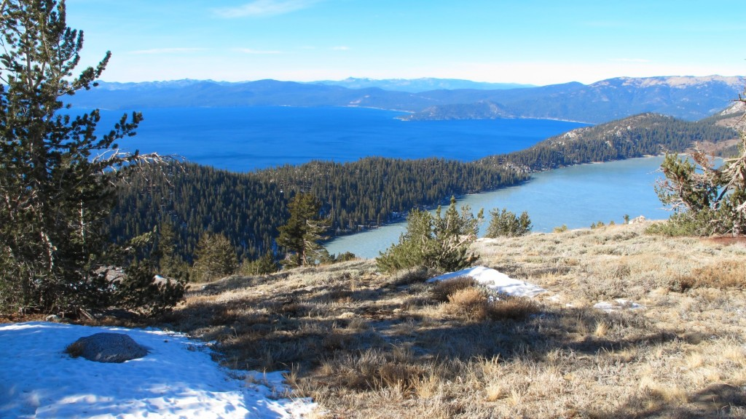

Capital Improvement Projects
Presented to the
State Public Works Board August 26, 2020
Steve Sisolak
Governor
Bradley Crowell
Director

Slide 2




2
Steve Sisolak
Governor
Bradley Crowell
Director
2021 CIP's DCNR (No Statewide Programs)
2021 Project No. | Project Name | DIV. |  | Dept. Final Rank | Total Project Costs
21236 | 9-Mile Stone House Rehabilitation (Walker River) | Parks |  | 1 | $3,737,660.00
19384 | Fort Churchill Park Facilities Maintenance & ADA Upgrades | Parks |  | 2 | $1,239,601.00
21275 | Comfort Stations Replacement at Valley of Fire | Parks |  | 3 | $816,297.00
21008 | Heavy Equipment Repair Shop and Shop Renovation | Forestry |  | 4 | $5,516,902.00
21274 | Valley of Fire Visitor Center Renovations | Parks |  | 5 | $838,314.00
19387 | Comstock Historic Museum Office Renovations | SHPO |  | 6 | $327,254.00
19192 | Las Vegas DCNR Multi Agency Building, A/E | DCNR |  | 7 | $721,684.00
7098 | Cathedral Gorge State Park-Safety Improvements Miller Point Overlook | Parks |  | 8 | $1,807,241.00
21009 | Spring Creek Residence/Fire Station Demolition | Forestry |  | 9 | $275,243.00
21224 | Building Weatherization & Envelope Protection (Phase II)-Spring Mountain Ranch State Park | Parks |  | 10 | $449,578.00
7571 | Western Region Headquarters Fire Apparatus Bay Addition | Forestry |  | 11 | $3,054,667.00
7562 | Install Emergency Generator-Northern Region 2 Headquarters | Forestry |  | 12 | $564,505.00
21190 | Wild Horse State Park-Restroom Replacement and Shower Facility | Parks |  | 13 | $1,429,474.00
21192 | Day-use Restroom Replacement-Wildhorse State Park | Parks |  | 14 | $538,224.00
21222 | Erosion Protection - Rye Patch State Recreation Area | Parks |  | 15 | $1,306,811.00
7544 | Wash Bay Addition and Saw and Paint Shop Upgrades Washoe Valley | Forestry |  | 16 | $1,006,256.00
7572 | Security Upgrades Ely Industrial Shop | Forestry |  | 17 | $400,448.00
7574 | Stewart CC Office Space Addition | Forestry |  | 18 | $1,350,741.00
7529 | Ely Industrial Shop Replacement | Forestry |  | 19 | $3,044,789.00
21198 | New Office Building Berlin Ichthyosaur State Park | Parks |  | 20 | $1,261,817.00
21176 | Boat Dock Replacement Spring Valley State Park | Parks |  | 21 | $775,650.00
 |  |  |  | TOTAL: | $30,463,156.00

Slide 3

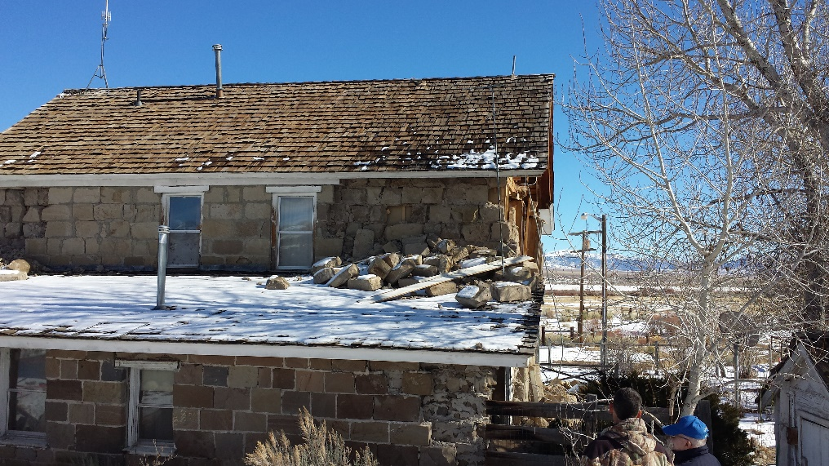
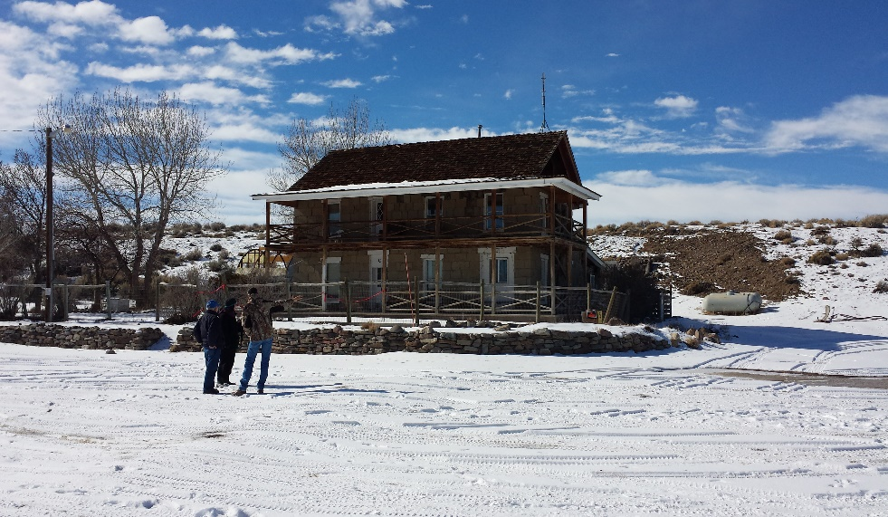
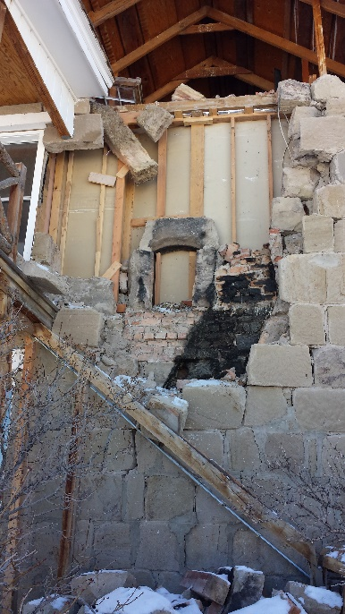
9-Mile Stone House Rehabilitation (Walker River) (21236)
3
This project will rehabilitate, restore, and seismically strengthen the 9 Mile Ranch Stone House at Walker River State Recreation Area.
PROJECT JUSTIFICATION:
This project will rehabilitate, restore, and seismically strengthen the 9 Mile Ranch Stone House at Walker River State Recreation Area. This project is needed to support the mission of Nevada State Parks at the Walker River State Recreation Area.
PROJECT BACKGROUND INFORMATION:
The structure was damaged by an earthquake in December 2016 and the State took ownership of it in July 2017. Programming, structural, and historical assessments were completed by H+K Architects, Nevada State Parks, and State Public Works in 2018 via project number 18-A005.
The SHPO also hired a Historical Architect to evaluate the structure. This report was submitted to the SHPO in April 2019.
HEALTH, LIFE SAFETY, AND/OR LEGAL ISSUES
The structure is currently unsafe for entrance by the public.
Although the structure is currently fenced and signed to discourage entry, those not heeding the warnings could potentially be injured or killed.
RAMIFICATIONS IF NOT APPROVED
If these repairs are not made, the structure will remain exposed to the elements causing further deterioration resulting in increased costs to restore it.
The building will remain closed and inaccessible to the public which goes against the legislative intent that authorized the purchase.
TOTAL PROJECT COST
$3,737,660.00

Slide 4
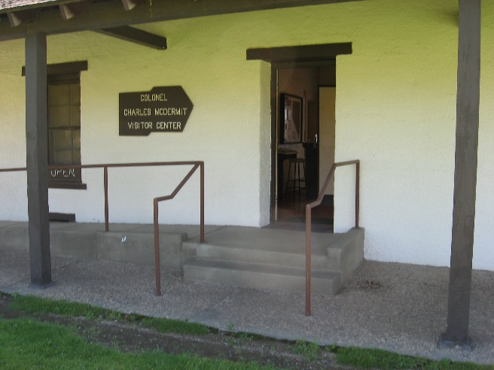
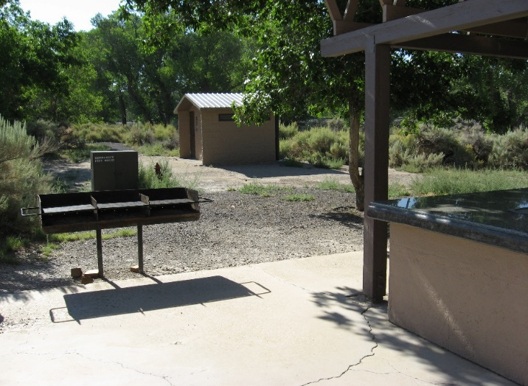
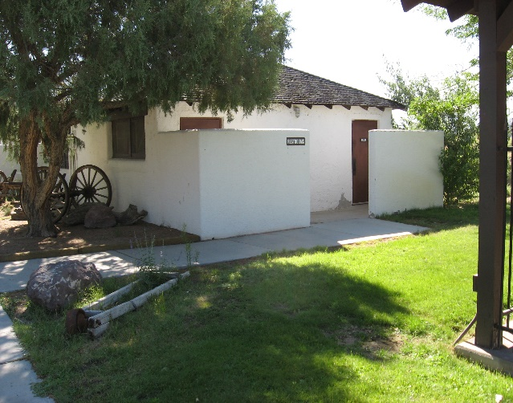
Park Facility Maintenance & ADA Upgrades at the Fort Churchill State Historic Park (19384)
4
Provide updates to the building's electrical, mechanical, and plumbing systems as well as upgrades to the restrooms and site for ADA code compliance at the Fort Churchill State Park Museum/Visitor Center, Shop/Office, and Shop/Public Restroom Buildings.
PROJECT JUSTIFICATION:
This project will replace electrical and mechanical system that have reached the end of their useful life. Replace failing plumbing fixtures with high efficiency units to conserve water. Bring Restrooms and walkways into ADA compliance.
PROJECT BACKGROUND INFORMATION:
The existing facilities were constructed between the 1930’s and the 1990's.
Ever evolving ADA laws have placed the majority of the facilities out of compliance. Some facilities can be retrofitted, while others are not capable of being retrofitted to meet current ADA standards and must be replaced.
This is a continuation of SPWD project #19-M53 which provided design through construction drawings.
HEALTH, LIFE SAFETY, AND/OR LEGAL ISSUES
Outdated electrical, mechanical and plumbing. Museum electrical are ungrounded outlets. ADA compliance throughout.
RAMIFICATIONS IF NOT APPROVED
If this project is not approved, the facilities will remain out of compliance and potentially unsafe for visitors and staff.
Should a complaint be submitted to the DOJ, the State will be required to provide fully compliant ADA facilities or close the facilities to the public.
TOTAL PROJECT COST
$1,239,601.00

Slide 5
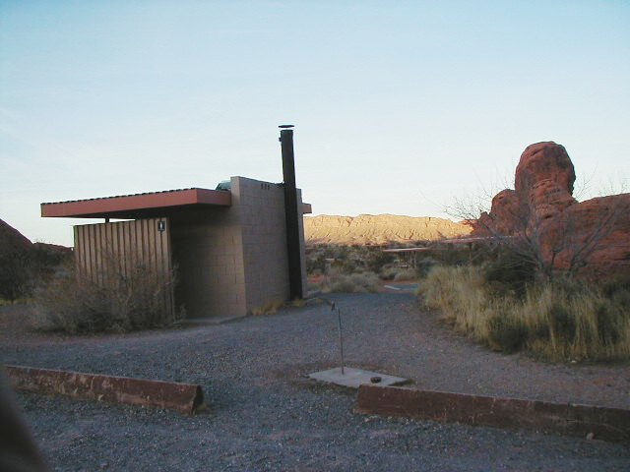
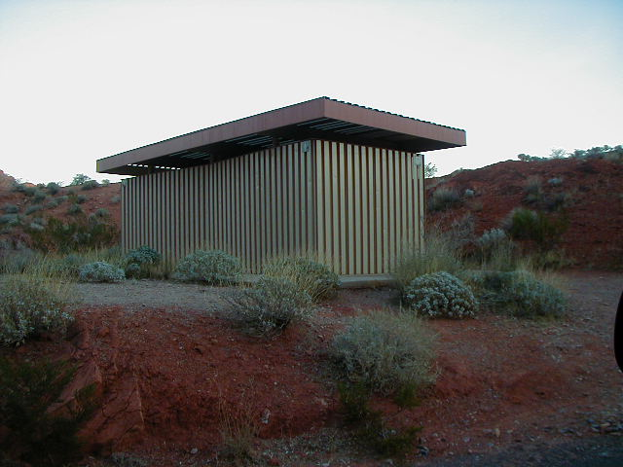
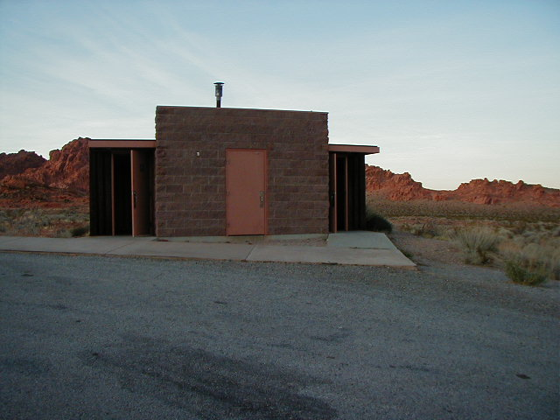
Comfort Station Replacement at Valley of Fire State Park (21275)
5
Install 6 new ADA compliant pre-manufactured comfort station at Valley of Fire State Park Campground.
PROJECT JUSTIFICATION:
The scope of this project is to provide and install an ADA compliant, pre-manufactured, pre-cast concrete, comfort station at various locations within Valley of Fire State Park. The comfort station will contain four ADA compliant restrooms and two ADA compliant showers. The current restrooms are over 45 years old, do not meet ADA requirements, and have exceeded their useful service life. The toilets are old and beginning to deteriorate
PROJECT BACKGROUND INFORMATION:
The existing restrooms were constructed in 1964 & 1975.
At the time of construction ADA laws had not been enacted. The existing units are not capable of being retrofitted to meet current ADA standards.
HEALTH, LIFE SAFETY, AND/OR LEGAL ISSUES
The existing comfort stations do not meet current ADA standards.
RAMIFICATIONS IF NOT APPROVED
If this project is not approved, the existing restroom will continue to deteriorate until they become unsafe for the public to use.
Should a complaint be submitted to the DOJ, the State will be required to provide a fully compliant ADA comfort station.
TOTAL PROJECT COST
$816,297.00
The existing facilities are 1960’s & 70’s cinder block and metal vault (no water) and wet buildings. They have gone beyond their serviceable life. They do not meet user expectations, nor are they ADA compliant.

Slide 6
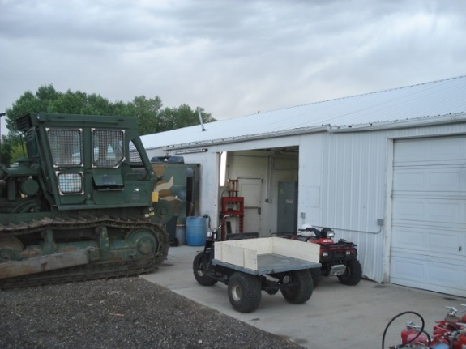
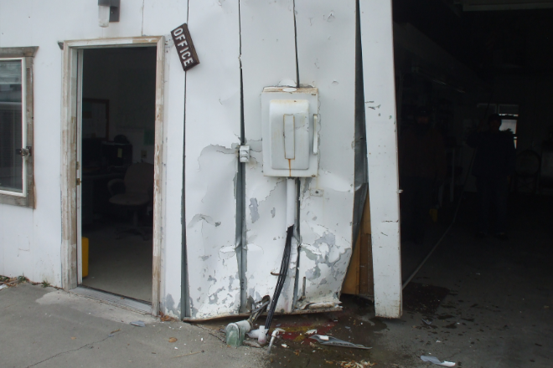
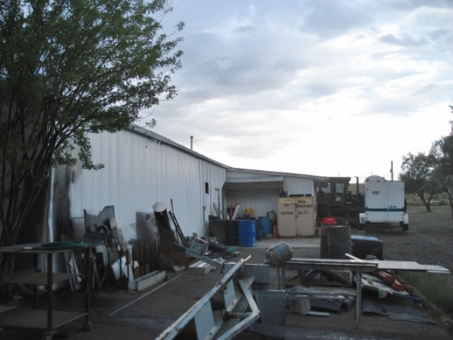
NDF Northern Region Heavy Equipment Shop and Renovations (21008)
6
This project is the continuation of 19-P08, design through construction of the 7,200 sf Heavy Equipment Repair Shop and renovation of the 4,880 sf Shop.
PROJECT JUSTIFICATION:
Existing facility is over 40 years old and is not in compliance with health and safety codes.
Facility was not designed to accommodate the size of today’s emergency response equipment.
Building inefficiencies, (windows, ventilation, & plumbing) result in higher than average energy consumption.
Personnel are forced to work outside in extreme weather conditions.
PROJECT BACKGROUND INFORMATION:
This project was requested every session since 2011 and advanced planning and design was approved in the 2019 session. The funds for this previously approved project were deferred in 2020.
HEALTH, LIFE SAFETY, AND/OR LEGAL ISSUES
This project would solve all code, ADA, health and life safety issues for this facility.
RAMIFICATIONS IF NOT APPROVED
The existing building has multiple physically restrictive issues and possible fire hazards.
The building will continue to be flooded during snow melt and major storm events causing disruption of services until the damage can be corrected. Repairs to vehicles too large for this facility will have to be repaired outdoors in an uncontrolled environment, and without proper life safety protection for the maintainers.
If this shop was decommissioned due to safety issues, the costs to contract the maintenance and repair activities out to a commercial vendor would be beyond the Division's financial capacity and likely the value of the building.
losing this facility would have a tremendous deleterious impact on emergency services.
TOTAL PROJECT COST
$5,516,902.00
Even smaller, older response vehicles are required to pull into the building sideways in order to perform work on them indoors. Even when staff are careful, this sometimes causes accidents.
Staff sometimes need to work in harsh weather, due to lack of space

Slide 7
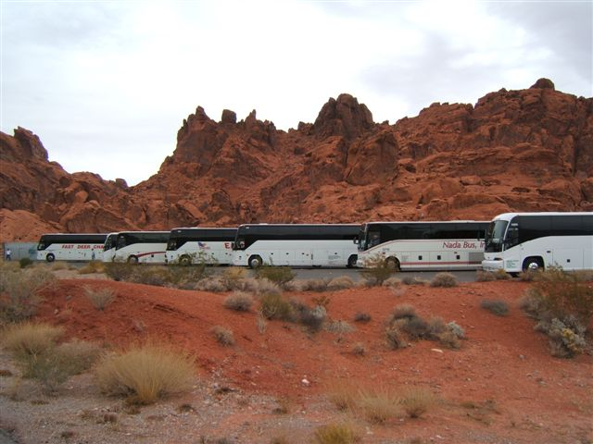
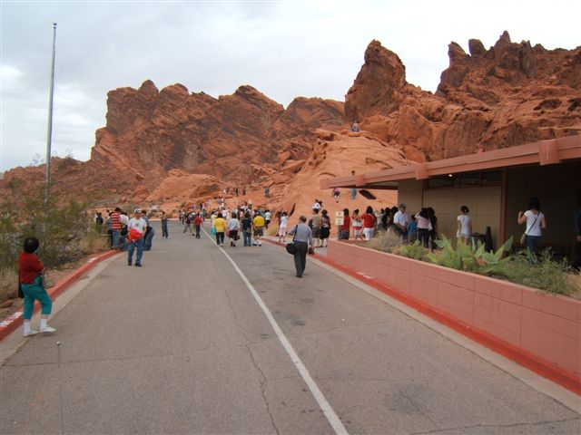
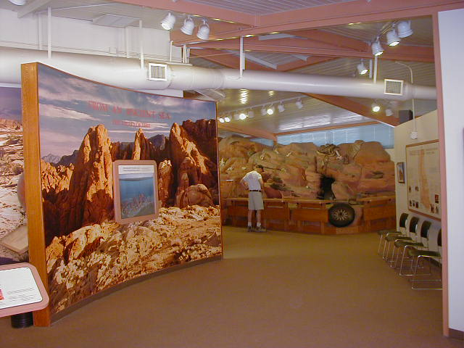
Visitor Center Renovations at Valley of Fire
State Park (21274)
7
Renovate the existing Visitor Center: Restrooms, flooring, lighting, paint, etc. at Valley of Fire State Park.
PROJECT JUSTIFICATION:
This project would remodel 3 Interior restrooms including all low flow fixtures. Consider exterior access doors to Men’s and Women’s. Provide necessary improvements to ADA restroom to bring to current code. This project would also renovate flooring to more durable low maintenance product, paint the interior, upgrade lighting to LED and add suspended acoustic panel to attenuate increased sound levels due to hard flooring.
PROJECT BACKGROUND INFORMATION:
The existing building was constructed in 1968 and has seen various improvements over the last 50 years. Increased visitation has accelerated the wear on the facility. Calendar year 2019 visitation was in excess of 843,000.
Building structure is sound and sufficient square footage.
Continuation of project 19-M36.
HEALTH, LIFE SAFETY, AND/OR LEGAL ISSUES
The existing restrooms do not meet current ADA standards. Fraying carpet may eventually cause tripping hazard.
RAMIFICATIONS IF NOT APPROVED
If this project is not approved, the existing facility will continue to deteriorate until it become increasingly expensive to maintain.
Should a complaint be submitted to the DOJ, the State will be required to provide a fully compliant ADA building to current standards.
TOTAL PROJECT COST
$838,314.00
The existing facilities were constructed in 1968

Slide 8
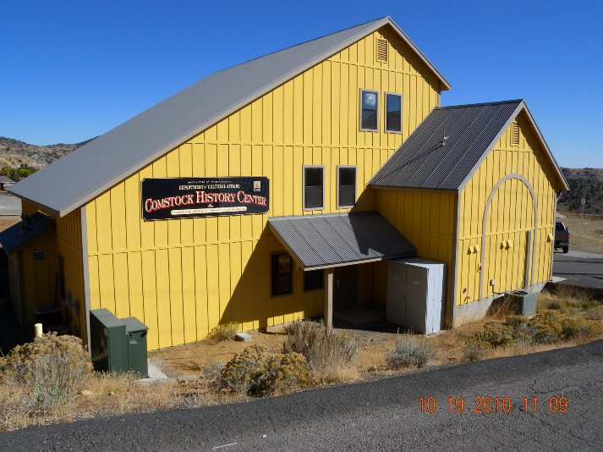
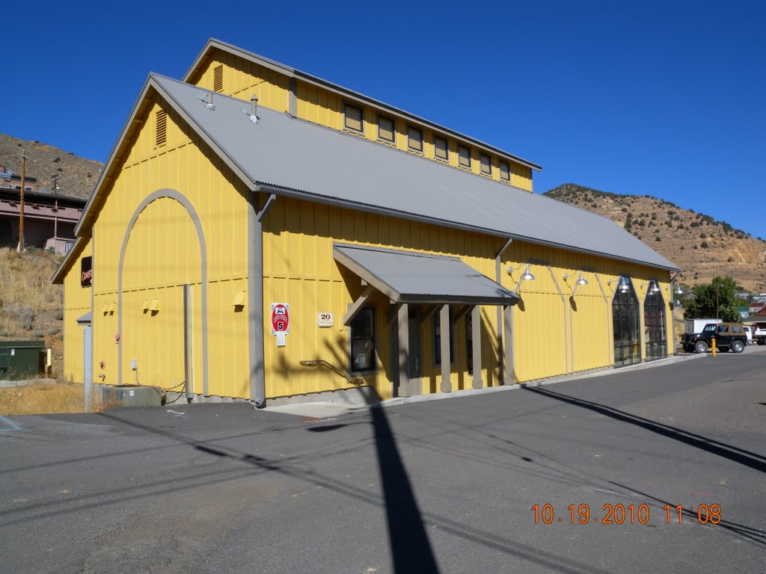

DCNR (SHPO) Comstock Historic Museum/Office Renovations Virginia City (19387)
8
The proposed project involves repairing and replacing failing building materials and systems.
PROJECT JUSTIFICATION:
The existing gaskets and glazing units have failed due to the freeze/thaw exposure and moisture infiltration within the system. The mechanical systems upgrades are necessary to protect the exhibits, control energy consumption, and aid user comfort in the Interpretive Exhibit Gallery. The large pair of wooden doors no longer hold the doors plumb and tight in the opening. It requires several personnel and additional mechanical means to operate the doors. The doors no longer fully shut or seal presenting large gaps where water, air, dust, and insects can pass freely. The interior wood doors have cracked leaving visible gaps that present privacy issues at the restrooms and office doors. The existing lighting in the Lobby, Conference/Meeting Room, and office areas are metal-halide, are not energy efficient and should be retrofitted with LED lamps. The existing lighting and walls of the Conference/Meeting Room do not allow for proper needed additional exhibit space even with the general lighting retrofit, therefore an art hanging gallery wall system and display lighting is needed.
PROJECT BACKGROUND INFORMATION:
The building was constructed in 2005 and is 4,000 square feet in area.
HEALTH, LIFE SAFETY, AND/OR LEGAL ISSUES
Due to the building envelop breaches, the artifacts/exhibits located within the building are subject to accelerated deterioration.
An HVAC system that does not properly function creates an unsafe work environment, especially at a location where the building experiences extreme weather conditions.
Continued deterioration of the building envelope will eventually allow rodent intrusion resulting in additional health risks to staff and the general public and damage to artifacts/exhibits.
RAMIFICATIONS IF NOT APPROVED
Artifacts/exhibits will continue to be exposed to outside element and pests causing accelerated deterioration.
The building will continue to deteriorate resulting in increased outside environment intrusion ultimately resulting in the structure being unfit for occupancy.
The longer this situation is allowed to exist, the higher the cost to repair the facility.
TOTAL PROJECT COST
$327,254.00

Slide 9
Las Vegas Multi-Agency Office A&E (19192)
9
Architectural and Engineering design of a new office complex to house all of DCNR in the region.
PROJECT JUSTIFICATION:
Economies would be realized for the subject agencies as well as the State as a whole by occupying one State-owned facility rather than leasing and maintaining multiple separate offices.
Parks, Forestry and SHPO currently occupying outdated facilities with high ongoing maintenance requirements, vandalism problems, and very poor energy efficiency. The remainder of the Department in Las Vegas are housed in leased facilities.
This project would provide a modern, State-owned building that would be tailored to the needs of the occupying agencies, would be energy efficient, and would utilize State dollars to construct a modern, State-owned building rather than for maintaining multiple aging buildings and paying rent to others.
Also, some of the current buildings are marginally sized for their staffing levels and are projected to be too small in the near future. All buildings have insufficient parking.
PROJECT BACKGROUND INFORMATION:
This project has been repeatedly requested since 2007 by both DCNR and NDOW. NDOW has now purchased a new building and move to that location.
The initial Programming CIP (07-P04) was done by Gary Guy Wilson Architects to provide programming, preliminary planning concepts, feasibility study and conceptual site plans.
Programming and site planning were updated in 2016.
The Department of Conservation and Natural Resources is now the lead agency due to NDOW’s departure.
Land has been secured through an R & PP lease from the BLM. The Initial land cost is $25/year for the lease.
HEALTH, LIFE SAFETY, AND/OR LEGAL ISSUES
DCNR currently occupies part of the facility at 4747 Vegas Blvd with an outbuilding that serves as equipment and vehicle storage, as well as a radio repair shop.
Vandalism and security are significant problems at this location. Vandals graffiti, deface vehicles, cut the perimeter fence, and cause all manner of general damage to the building.
Employees feel unsafe at work, especially when travelling between the office and their vehicles early in the morning or late in the evening.
In 2019 the Department of Wildlife (NDOW) vacated the complex located at 4747 Vegas Drive and due to the acquisition source of the existing property, NDOW may be required to sell the property in the near future, leaving Parks, Forestry and SHPO without an office space.
RAMIFICATIONS IF NOT APPROVED
Money will continue to be spent on the ever-increasing maintenance needs of multiple obsolete buildings.
Parks, Forestry and SHPO may need to locate alternate lease office space in Las Vegas.
TOTAL PROJECT COST
$721,684.00

Slide 10
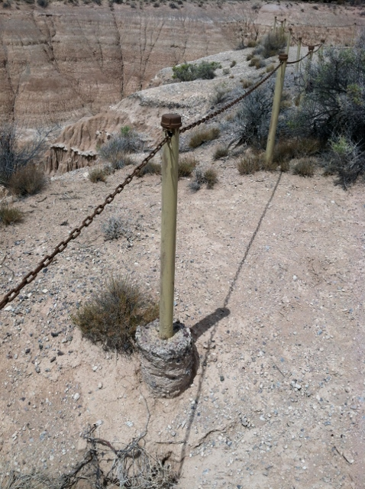
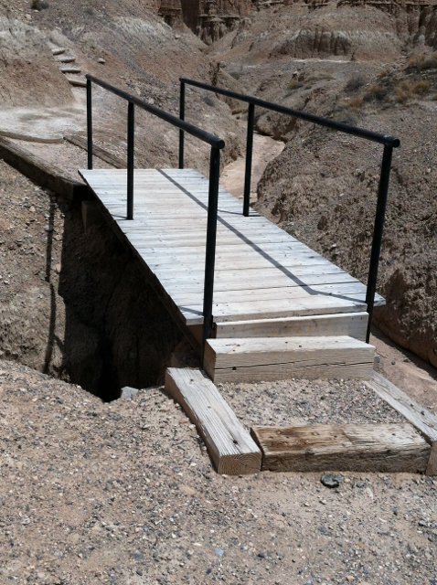
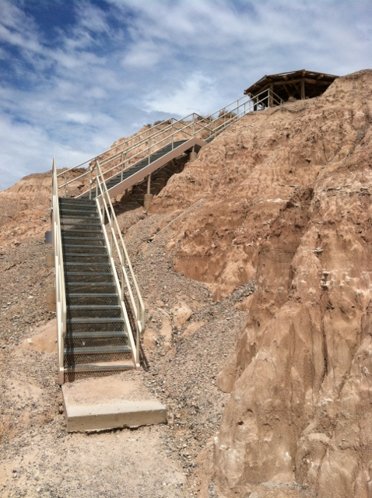
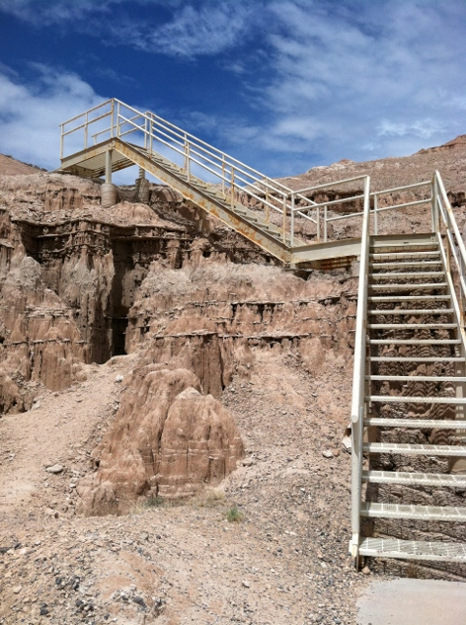
Life Safety Improvements - Millers Point Overlook, Cathedral Gorge State Park (7098)
10
Life safety rehabilitation of trailhead stair structure, foundations, guardrails and bridge. It will be necessary for a complete reconstruction of the guardrail system. Installation of life safety cable rail or fence at edge of canyon.
PROJECT JUSTIFICATION:
This steel framed trailhead stairway is the sole access point to the canyon below. It is used quite often. Erosion appears that it may be compromising the foundations. The Guardrail is not code compliant. the bridge may need to be rebuilt or extended to protect trail users from falling into areas that are eroding.
PROJECT BACKGROUND INFORMATION:
This structure was built in the late 1990's and was built in/on highly erosive soils. It is located in a free access area along highway 93, north of the Cathedral Gorge State Park main entrance.
Miller Point Overlook hosts approximately 19,000 visitors annually.
This project has been requested in 2015, 2017 & 2019 CIP’s.
HEALTH, LIFE SAFETY, AND/OR LEGAL ISSUES
This project is exclusively to mitigate code & life safety issues at the subject site. None of the railings comply with code to prevent falls.
RAMIFICATIONS IF NOT APPROVED
If this project is not approved, the area may have to be closed and the improvements blockaded, to reduce potential trip/fall hazards in the area as well as possible structural failure due to undermining of the supports from erosion.
TOTAL PROJECT COST
$1,807,241.00
New Bridge & Guard Rails Required
Guard Rail Required
New Guard Rails Required
New Guard Rails Required

Slide 11

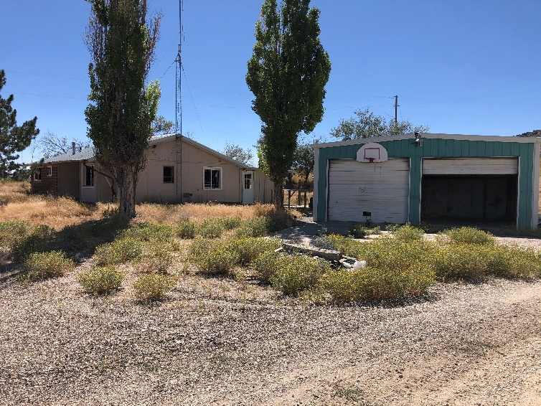
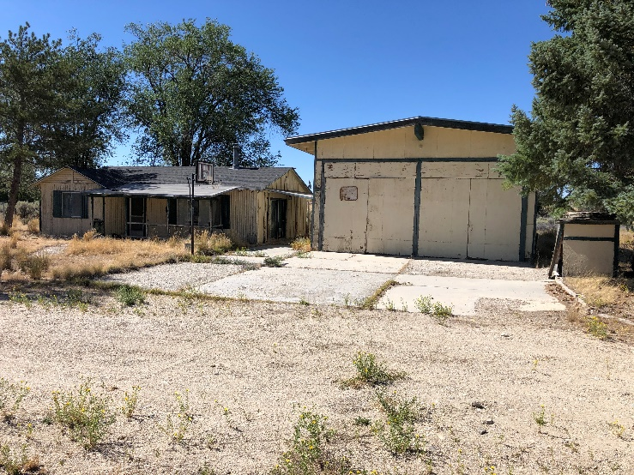
Spring Creek Residence/Fire Station Demolition (21009)
11
Demolition of multiple dilapidated structures and limited site restoration.
PROJECT JUSTIFICATION:
The 2015 legislature closed 473 fire districts and officially consolidated equipment and personnel throughout the State of Nevada. Structures still remain at these two sites.
PROJECT BACKGROUND INFORMATION:
The facilities were private residences purchased by the State and then converted into fire stations. The structures were originally constructed in the late 1960's or early 1970's.
HEALTH, LIFE SAFETY, AND/OR LEGAL ISSUES
Both facilities have been vandalized and currently are unlockable. The buildings are periodically entered by neighborhood kids and transients.
RAMIFICATIONS IF NOT APPROVED
Should this project not be funded, the structures will remain, continue to deteriorate, attract vandals and become an increasing safety hazard.
TOTAL PROJECT COST
Approx. $275,243.00

Slide 12
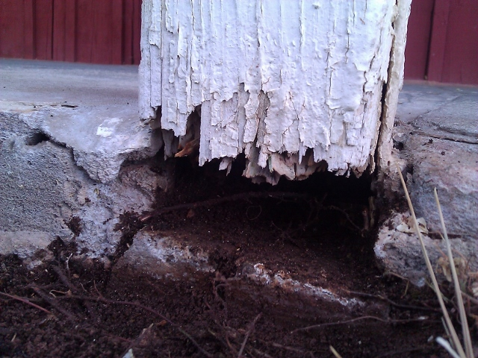
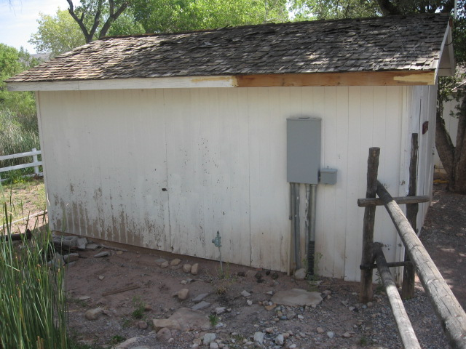
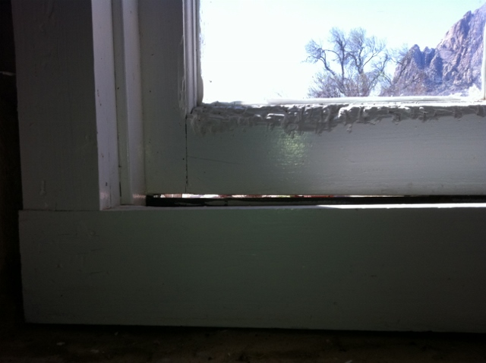
Building Weatherization & Envelope Protection at Spring Mountain Ranch State Park, Phase II (21224)
12
Engineering evaluation and report of various structures at the Spring Mountain Ranch State Park.
PROJECT JUSTIFICATION:
The purpose for this project is for an engineering design through construction drawings and recommendation for the sequencing of future repairs to keep water, sand and debris from entering the buildings, protect siding and wood framing.
PROJECT BACKGROUND INFORMATION:
Buildings on this site date from 1870 to 2005.
This project being requested is Phase II, a continuation of 19-P10.
Spring Mountain Ranch hosts approximately 260,000 visitors annually.
HEALTH, LIFE SAFETY, AND/OR LEGAL ISSUES
Leaking roofs will allow water intrusion, roof sheathing, framing and internal contents can be damaged by this intrusion, causing potential failure. This is a threat to the resources at this site and a hazard to the visiting public and staff.
RAMIFICATIONS IF NOT APPROVED
If this project is not approved, the buildings on this historic site will continue to deteriorate, leak and will ultimately fall into a state of failure, thus losing these valuable and historic resources.
NOTE:
This phase includes a detailed independent engineering design and construction drawings to include recommendations as to the sequence that repairs should take place.
TOTAL SPWD PROJECTED COST
$449,578.00
Earth to wood contact, rotting wood.
Failing roof, paint just about gone.
Window out of square, weather comes in.

Slide 13
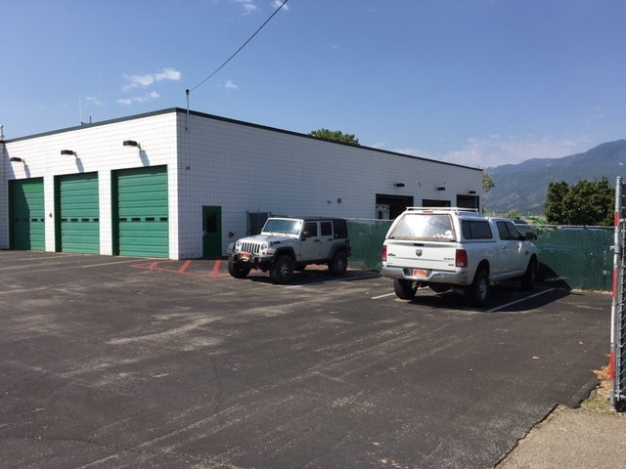
Apparatus Bay Addition Western Region HQ (7571)
13
This project will design and construct a 3,000 sf addition to the Emergency Fire Apparatus Bay facility
PROJECT JUSTIFICATION:
Significant emergency fire response apparatus is currently stored outside during the entire year and subject to all weather extremes and conditions. For staff to be able to respond to various emergency incidents safely, it is essential that fire fighting equipment be properly stored and protected. Maintenance personnel are routinely tasked with completing costly repairs to damaged equipment that is continuously exposed to weather extremes and the elements.
PROJECT BACKGROUND INFORMATION:
The Apparatus Bay building was constructed in 1980. This project was requested in 2015, 2017 & 2019.
HEALTH, LIFE SAFETY, AND/OR LEGAL ISSUES
Maintenance personnel are routinely tasked with completing costly repairs to damaged equipment that is continuously exposed to weather extremes and the elements.
Inadequate electrical service and lighting can result in an unsafe work environment and reduced staff efficiency.
RAMIFICATIONS IF NOT APPROVED
Should this project not be funded, year-round weather conditions will continue to deteriorate vehicles and various equipment attached to the fire apparatus such as hoses, gauges, vinyl covers, and water and foam pump housings.
TOTAL PROJECT COST
$3,054,667.00

Slide 14
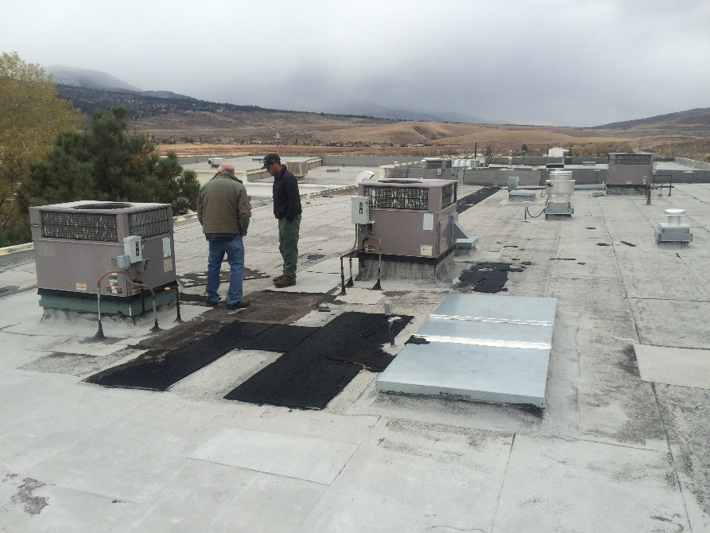
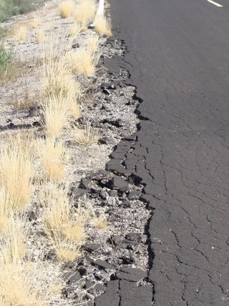
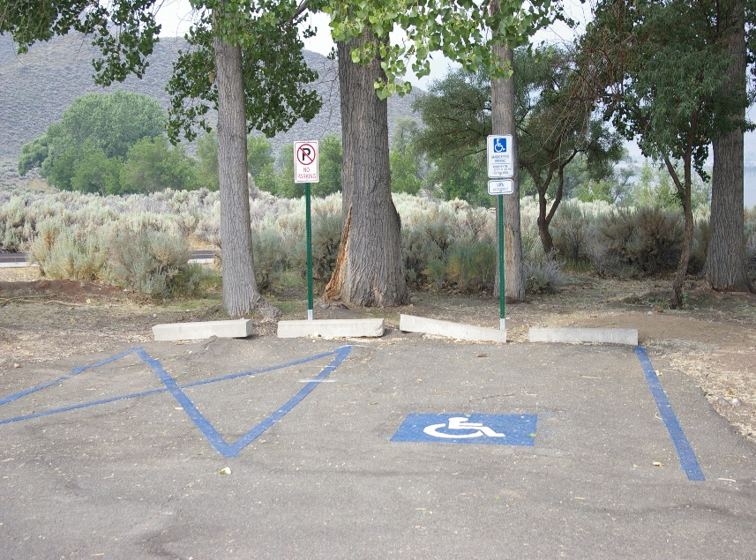
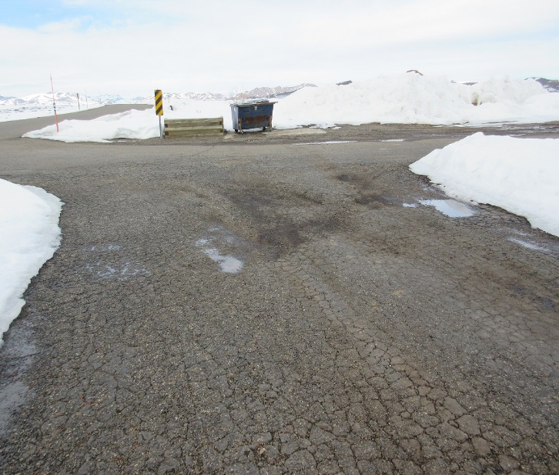
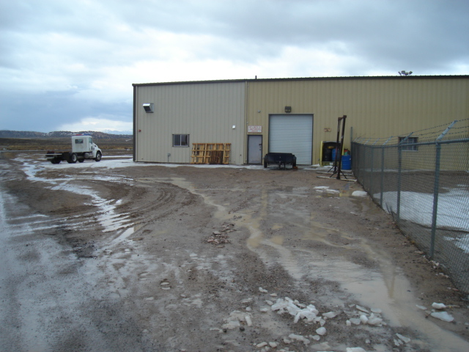
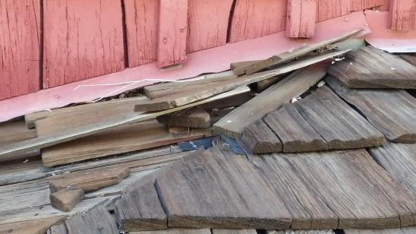
State Parks & NDF, Statewide Projects
Paving, Roofing, ADA & HVAC
14

